Slide 1
Smart Irrigation System

Slide 2

IoT Project (CSE 426)
Supervised by
Md. Hasibur Rahman Lecturer Department of CSE Bangladesh university of Business and Technology (BUBT)
Submitted by
Syeda Nowshin Ibnat | 17183103020
Mahmuda Begum | 17183103030
Nusrat Jahan Anka | 17183103008
Nawrin Zaman Prova | 17183103043
Intake: 39(1), Dept. of CSE, BUBT
Presented Date: 08-12-2021

Slide 3
Table of contents
Introduction
Problem Background
Motivation
Objective
Project Schedule
Working process
System Analysis
Circuit Design
Experimental Setup
Project Features
Hardware Specification
Software Specification
Network Connection
IoT Cloud
Mobile App
Limitations
Future work
Conclusion
Reference

Slide 4
Introduction
IoT is transforming agriculture and allowing farmers to overcome the enormous challenges they face. Smart irrigation systems reduce the chances of over-watering the soil and waterlogging in the fields. In our system, the moisture level in the soil is monitored and the IR sensor is used for intrusion detection.

Slide 5
Problem Background
Since the dawn of civilization, humans have used numerous techniques to produce food and large-scale crops were required. The main issue occurred when insufficient human labor slowed agricultural development.

Slide 6
Motivation
Know about the agro-tech work using IoT.
Get more knowledge on Hardware and IoT.
Test feasibility of our work.

Slide 7
Objectives
To develop an IoT-based Smart irrigation system having low-cost equipment.
To monitor moisture contents at different conditions.
To get accurate IR sensor value.
To improve the system by storing data on the cloud and using Mobile Phone App.
To do proper circuit design for the project.
To do proper testing and debugging of the device configuration.

Slide 8
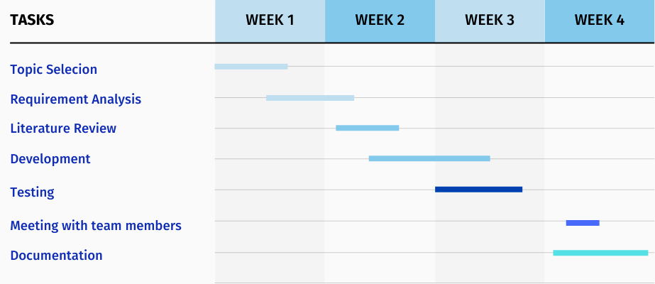
Project Schedule

Slide 9
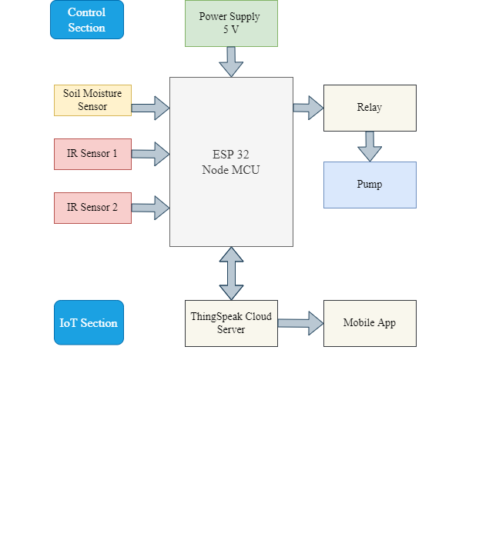
Working Process
Figure 1: Block Diagram of Smart Irrigation System

Slide 10
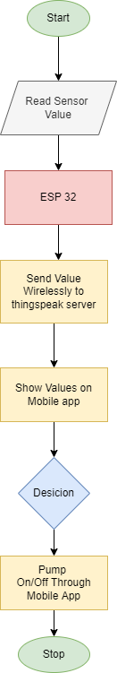
System Analysis
Figure 2: Flow Chart of Smart Irrigation System

Slide 11
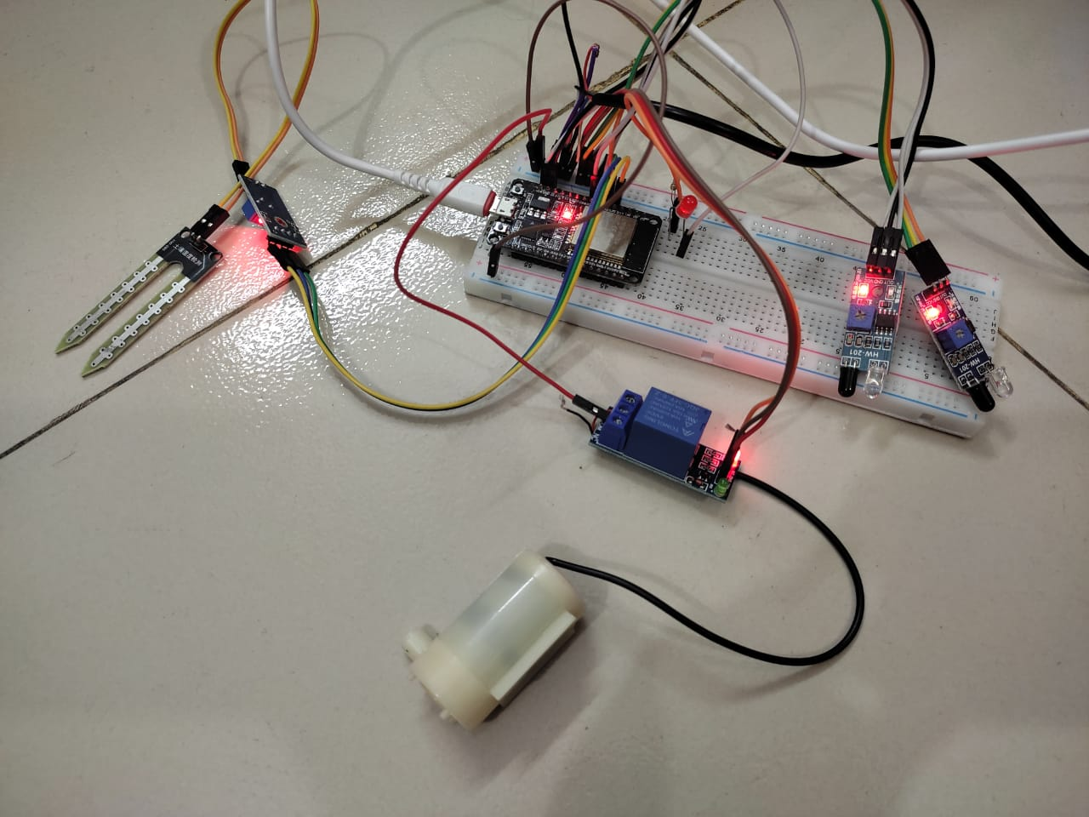
Circuit Design

Slide 12
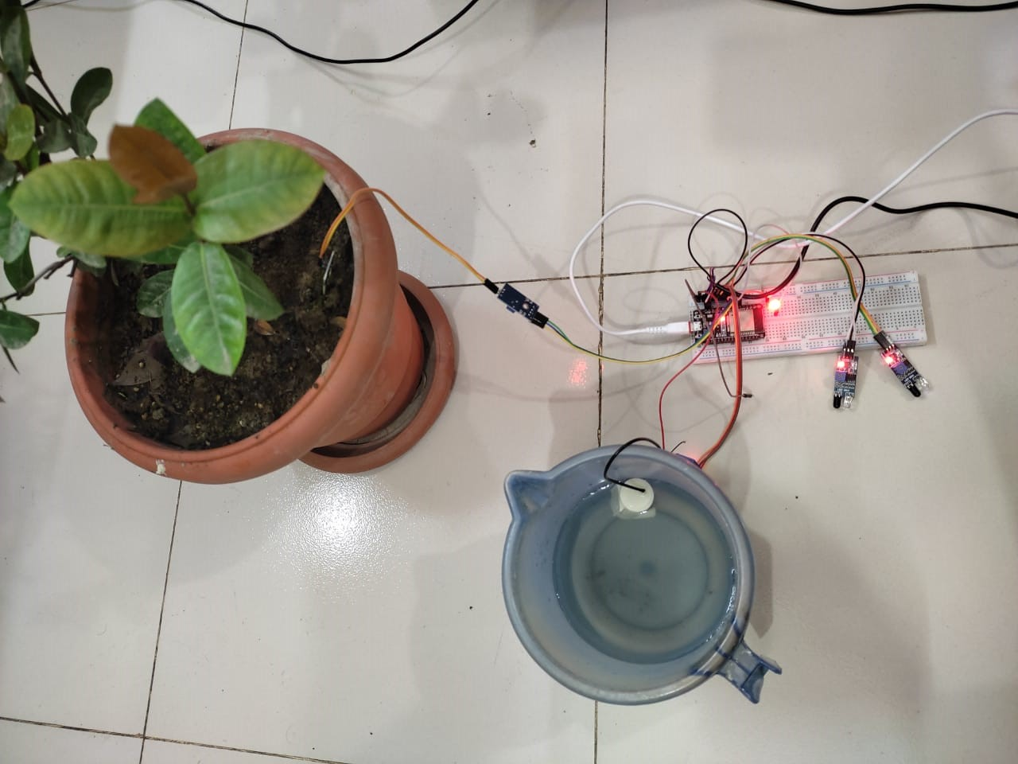
Experimental Setup

Slide 13
Project Features
Our system can give accurate data of moisture sensor.
We can handle two IR sensor to detect intrusion.
Data store on ThingSpeak IoT cloud.
Mobile App for the user to see data visualization.
Switch to On/Off the Pump.

Slide 14
Hardware Specification
No | Hardware | Unit(s) | Specification
1. | Breadboard | 1 | To set up the components.
2. | Jumper Wire | 1 | To make connection.
3. | Resistor | 1 | To control current flow.
4. | USB Cable | 2 | Power Supply.
5. | ESP 32 - 3.3V | 1 | System on Chip (Bluetooth and WiFi module integrated).
6. | Soil Moisture Sensor- 5V | 1 | Measure soil moisture.
7. | IR Sensor- 5V | 2 | Intrusion detection.
8. | Relay - 5V | 1 | Used as a switch for pump.
9. | Pump - 5V | 1 | Used for irrigation.

Slide 15
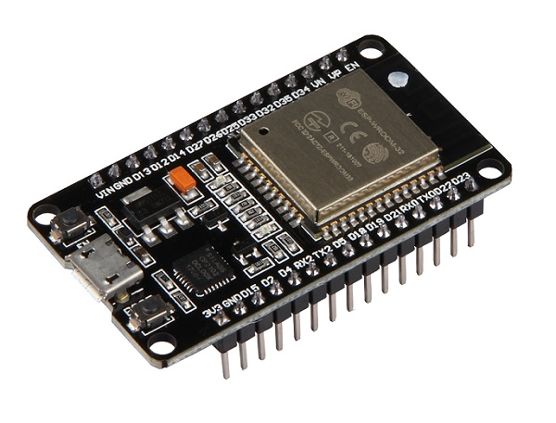
Hardware Specification Cont.
ESP32
ESP32, a low-cost System on Chip (SoC) Microcontroller with integrated Wi-Fi and Bluetooth. There are many ESP32 Boards based on ESP-WROOM-32 Module available in the market. The board which we have has 30 Pins (15 pins on each side).
Figure: ESP32 MCU

Slide 16
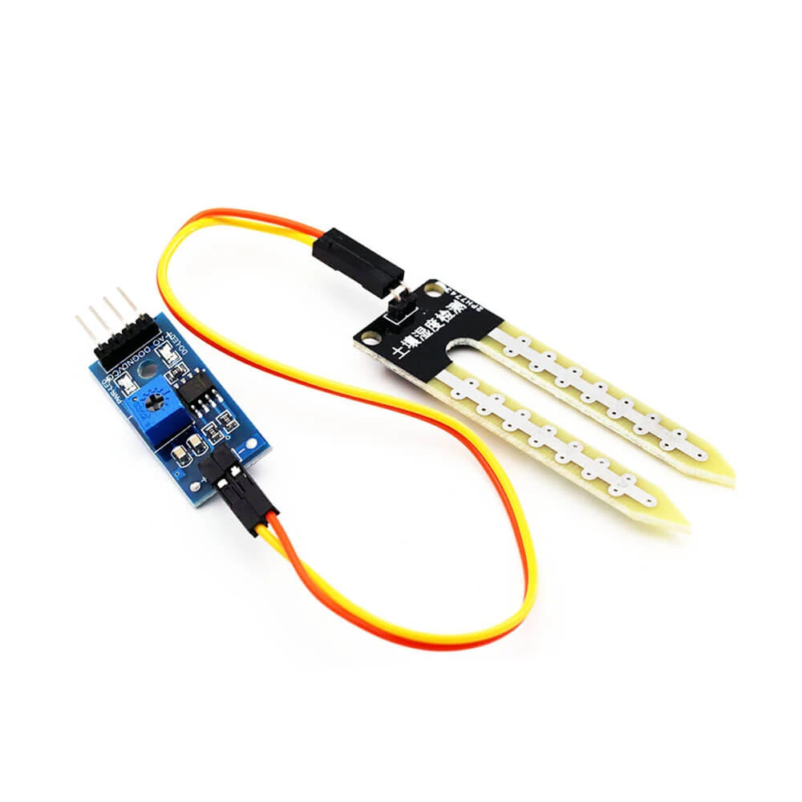
Hardware Specification Cont.
Soil Moisture Sensor
The soil moisture sensor module is used to detect the moisture of the soil. It measures the volumetric content of water inside the soil and gives us the moisture level as output.
Figure: Soil Moisture Sensor Module

Slide 17
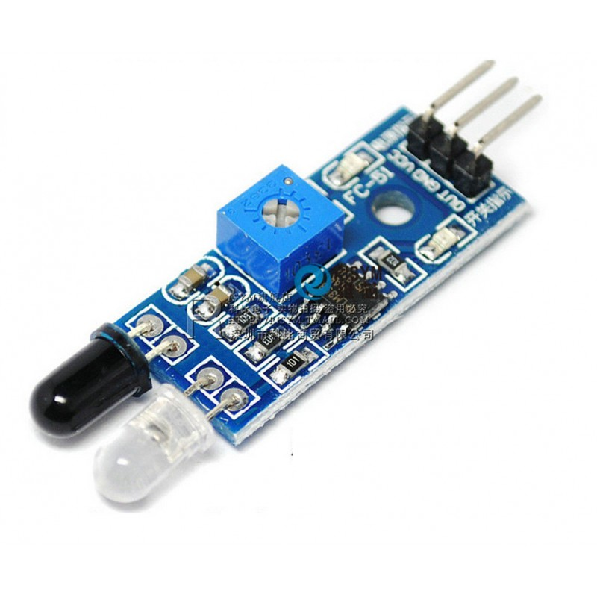
Hardware Specification Cont.
IR Sensor
An infrared sensor is an electronic device, that emits in order to sense some aspects of the surroundings. An IR sensor can measure the heat of an object as well as detects the motion.
Figure: IR Sensor Module

Slide 18
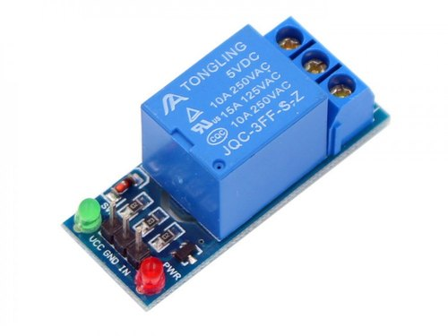
Hardware Specification Cont.
Relay
Relay is an electromechanical device that uses an electric current to open or close the contacts of a switch.
Figure: 5V Relay

Slide 19
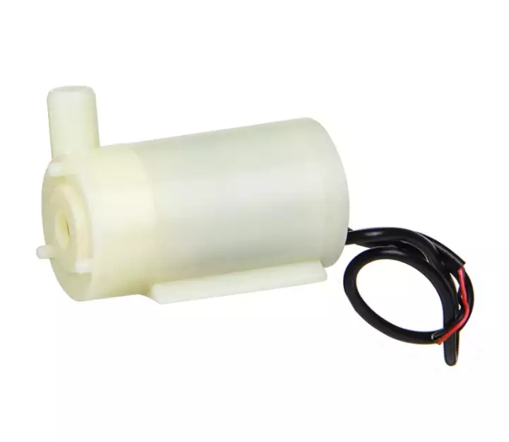
Hardware Specification Cont.
Pump
It’s a Low voltage water pump Using 5V voltage. It used for watering from time to time.
Figure: Micro Water Pump

Slide 20
Software Specification
No | Code Development | Language used | Cloud Server | Mobile App
1. | Arduino IDE | Arduino C | ThingSpeak | MIT App Inventor

Slide 21
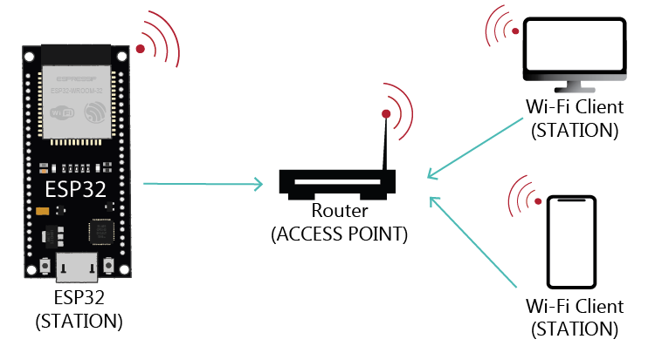
Network Connection
Connection with the ESP32 Wi-Fi network by using specific SSID and password.

Slide 22
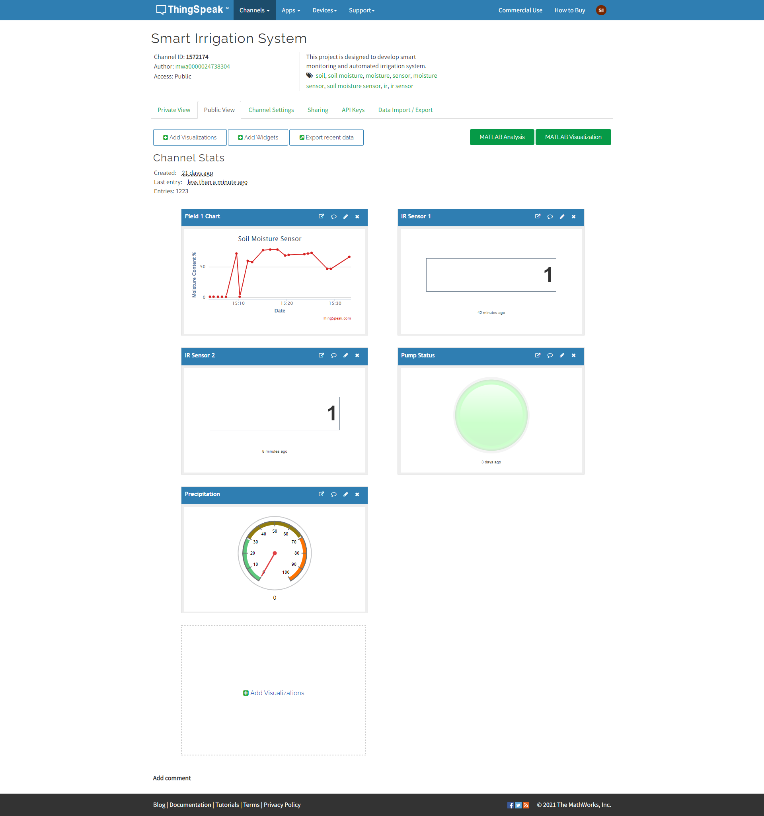
IoT Cloud

Slide 23
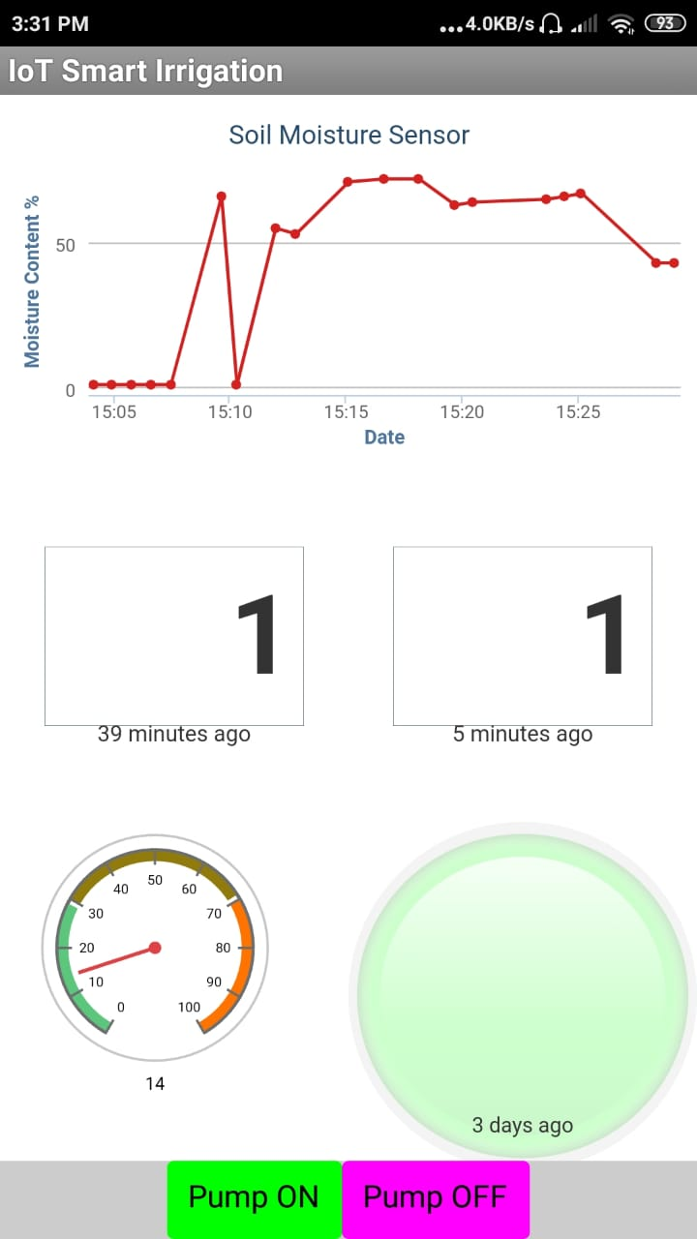
Mobile App

Slide 24
Limitations
We can not notify the user for Intrusion detection.
Slow data processing.
Without WiFi we can not use this system.

Slide 25
Future Works
Notification system for intrusion detection.
Monitoring of soil moisture content
Automatic Control system.

Slide 26
Conclusion
We developed a system by which users can get soil moisture values and can detect intrusion. Sensor values will store on Thingspeak. By using the app users can turn the pump on or off.

Slide 27
Resources
ESP32 Publish Sensor Readings to ThingSpeak (easiest way)
ESP32 Arduino: Getting weather data from API
ESP32 + MIT App Inventor Mini-Project Demo! | DIY Wifi RGB LED Controller - Part 1
ESP32 + MIT App Inventor Mini-Project Demo! | DIY Wifi RGB LED Controller - Part 1

Slide 28
Thanks!
Do you have any questions?

